Slide 1



05/07/2020

Slide 2




EXECUTIVE SUMMARY
APPROACH
Px
Dx
PATIENT LEVEL
30 RANKED SUB-CLUSTERS LABELLED
1-A to 5-F
CLUSTERING ALGORITHM
Rx
ZIP CODE LEVEL
~ 28 Million Patients
INSIGHTS
RANKS 1 -15
RANKS 16 -30
NNI AOM Enthusiasts
NNI AOM Convertibles
NNI AOM Potentials
NNI AOM Rejects
NNI AOM Hopeless
RECOMMENDATIONS
MARKETING CAMPAIGNS,
INVESTMENT EFFORTS, & FUTURE PORTFOLIO: SEMA-O
NNI AOM Convertibles
Increase pool of NNI AOM Enthusiasts
POTENTIAL REVENUE:
> $17 Billion*
Directed To
Impact
Result
NNI AOM Potentials
Establish relationships with more NNI AOM HCPs
* Assumptions: 1) Saxenda’s lifetime value of $6,300 2) Stay-time of at least 6 months 3) Target 20% market share (Increase from current 6%)

Slide 3


THE CLUSTERING PROCESS
28 Mil Patients
1
1-A
1-B
2
5
3
4
1-C
1-D
1-E
1-F
2-A
2-B
2-C
2-D
2-E
2-F
3-A
3-B
3-C
3-D
3-E
3-F
4-A
4-B
4-C
4-D
4-E
4-F
5-A
5-B
5-C
5-D
5-E
5-F
Patient Level:
Clusters 1 - 5
PATIENT RELATIONAL DATABASE
2-B
Patient Cluster 2:
Patient cohort that has
Relatively higher paid Saxenda claims
Higher % of Comorbidities
Lowest % of male patients
Lives in ZIP Code Group B: Geographies that are
Located mostly in the Eastern states
Higher household incomes
Low unemployment rate
ZIP Code Level:
Groups A - F

Slide 4
AGENDA
1
PATIENT RELATIONAL DATABASE
2
INSIGHTS AND VISUALIZATIONS
3
MODEL OUTPUT
4
RECOMMENDATIONS

Slide 5

PATIENT RELATIONAL DATABASE
PATIENT FLAT TABLE
PRESCRIBER FLAT TABLE
Patient ID
Prescriber ID
Address
State
ZIP Code
Saxenda target
Diagnosis Doctor & Prescriber information
Date of Birth
Gender
Diagnosis dates
BMI
Obesity
Consultation and Surgery Information
Medical claims
Prescribed AOMs
Prescription Dates
PLANTRAK FLAT TABLE
Diagnosis & Prescription Health Insurance Plan information
Plantrack ID
Method of payment
Model type
Category Code
SOCIOECONOMIC FLAT TABLE
Doctor & Prescriber’s addresses
City
State
Population Information
Economic Indicators
ZIP Code

Slide 6
AGENDA
1
PATIENT RELATIONAL DATABASE
2A
INSIGHTS AND VISUALIZATIONS – PATIENT LEVEL
3
MODEL OUTPUT
4
RECOMMENDATIONS

Slide 7

MODEL INSIGHTS – PATIENT LEVEL
CLUSTER 1
CLUSTER 2
CLUSTER 3
High Priority
Medium High Priority
Medium Low Priority
1M patients
0.5M patients
2M patients
Largest number of paid claims and stay-time across all AOMs and the most Saxenda prescriptions
Highest percentage of Tier 1 and Tier 2, and lowest percentage of Tier 3 Saxenda prescribers
Highest median household income
Second largest Saxenda prescriptions, paid claims and stay-times across branded AOMs
Second highest percentage of Tier 1 and Tier 2 Saxenda prescribers
Second highest percentage of patients diagnosed with obesity and comorbidities
Only group with consultations, surgery, screenings
Prescribed mostly generic AOMs, and very few branded AOMs
Only cluster with rejected Saxenda prescriptions
Third highest percentage of Tier 1 and Tier 2 Saxenda prescribers
Third highest median household income
CLUSTER 4
CLUSTER 5
Low Priority
Separate Group
5M patients
19.5M patients
Only prescribed Generic AOMs
Highest percentage of Tier 3, and second lowest Tier 1 and Tier 2 Saxenda prescribers
Lowest percentage of patients diagnosed with obesity and comorbidities
Highest PBM Commercial Insurance Model
Lowest median household income
Patients are only in the Dx table with no prescription information
Highest percentage of Non-Targeted Saxenda prescribers
Highest percentage of patients diagnosed with obesity and comorbidities
Highest percentage of male patients

Slide 8
DISTRIBUTION OF PAID CLAIMS ACROSS AOMS
Cluster 1:
Prescribed all kinds of AOMs and have the most Saxenda prescriptions
Cluster 2:
Prescribed mostly non-Saxenda AOMs, but has second largest Saxenda prescriptions
Cluster 3:
Prescribed mostly generic AOMs and some Contrave AOMs
Cluster 4:
Patients prescribed only generic AOMs
Cluster 5:
Patient in the DX database and have on information on RX claims

Slide 9

GROSS RENT & HOUSEHOLD INCOME
MEDIAN GROSS RENT
MEDIAN HOUSEHOLD INCOME
Cluster 1 has the highest gross rent and household income, but generally differences across clusters are marginal

Slide 10
2019 TOP 50 PERCENTILE SAXENDA DTC TARGETS OVERLAPS
Top 50 Percentile ZIP Codes
CLUSTER 2
CLUSTER 1
13.9K ZIP Codes
13.8K ZIP Codes
62.9%
55.3%
1051
2263
1246
2458
1737
Top 4000 Cluster ‘_’ ZIP Codes
1542
CLUSTER 3
CLUSTER 4
CLUSTER 5
15.8K ZIP Codes
15.7K ZIP Codes
17.9K ZIP Codes
47.6%
41.5%
46.9%
1461
2673
1631
2843
1210
2932
1327
1157
1068

Slide 11
AGENDA
1
PATIENT RELATIONAL DATABASE
2B
INSIGHTS AND VISUALIZATIONS – ZIP CODE LEVEL
3
MODEL OUTPUT
4
RECOMMENDATIONS

Slide 12

MODEL INSIGHTS – ZIP CODE LEVEL
GROUP A
GROUP B
GROUP C
High Priority
Medium High Priority
Medium Priority
1.5K ZIP Codes
300 ZIP Codes
820 ZIP Codes
Highest ratio of paid Saxenda claims to other AOM claims
Highest percentage of Tier 1 and Tier 2 Saxenda prescribers
Highest percentage of people with high education and median household income
Second highest ratio of paid Saxenda claims
Second highest percentage of Tier 1 and Tier 2 Saxenda prescribers
Second highest percentage of patients diagnosed with obesity and highest for comorbidities
Second highest median household income
Third highest overall number of paid claims with very little Saxenda prescriptions
Only Tier 3 Saxenda prescribers
Highest percentage of patients diagnosed with comorbidities and second highest for obesity
Highest unemployment rate
ZIPCODE – LEVEL
GROUP D
GROUP E
GROUP F
Medium Low Priority
Low Priority
Separate Group
4.7K ZIP Codes
11.1K ZIP Codes
1.1K ZIP Codes
Second lowest overall number of paid claims
Second lowest percentage of patients diagnosed with obesity and comorbidities
Third lowest unemployment rate
Lowest percentage of people with high education
Lowest overall number of paid claims
Lowest percentage of all types of Saxenda prescribers
Lowest percentage of patients diagnosed with obesity and comorbidities
Second lowest median household income
Number of patients in each Zip Code exceed the population of that Zip Code
Second lowest unemployment rate
Second highest percentage of people with high education
Lowest median household income

Slide 13
DISTRIBUTION OF PAID CLAIMS ACROSS AOMS
Group A has the best ratio of Saxenda to other AOMs claims
Group B is the only other group with Saxenda paid claims
Group C and D are mostly prescribed generic and other branded AOMs
Group E has the least number of claims of all types of AOMs

Slide 14
GROSS RENT & HOUSEHOLD INCOME
MEDIAN GROSS RENT
MEDIAN HOUSEHOLD INCOME
Group A has the highest median gross rent and household income across all groups

Slide 15
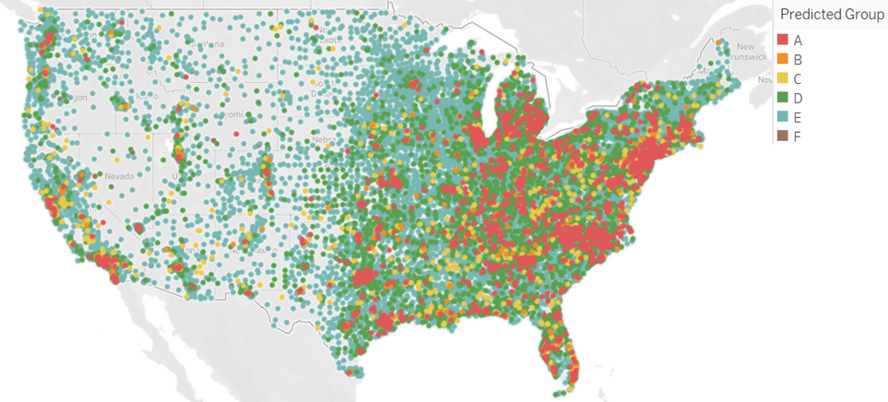
DISTRIBUTION OF ZIP CODE GROUPS

Slide 16
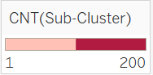
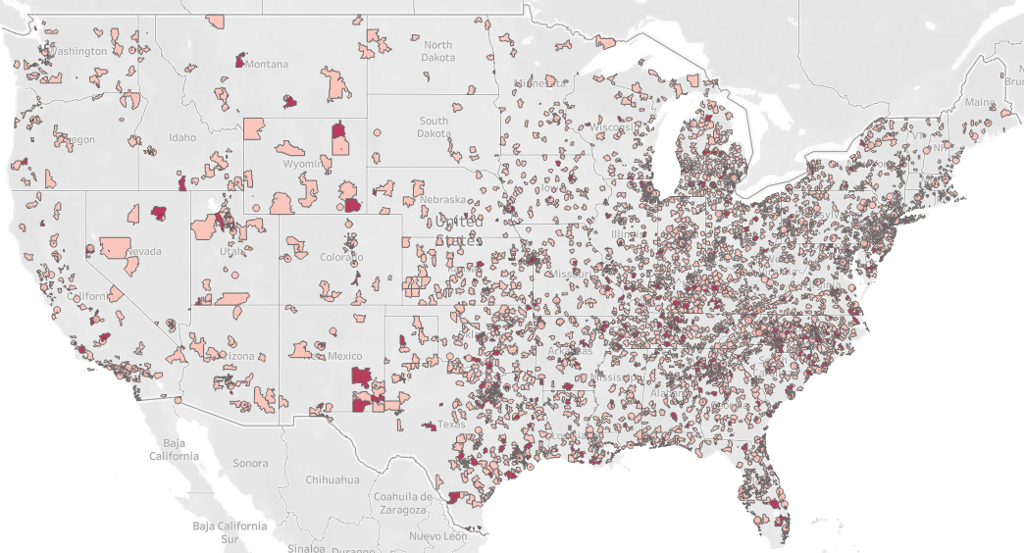
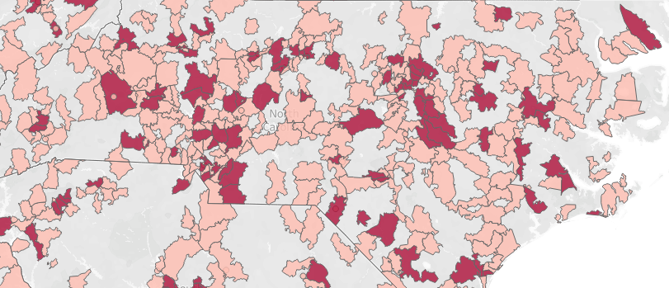
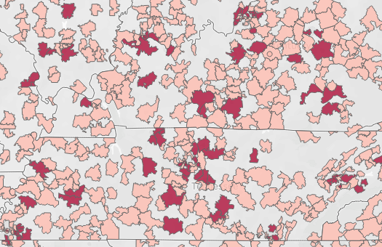
GEOGRAPHICAL REGIONS OF ‘CONVERTIBLES’
NNI AOM CONVERTIBLES
NC
KY & TN

Slide 17
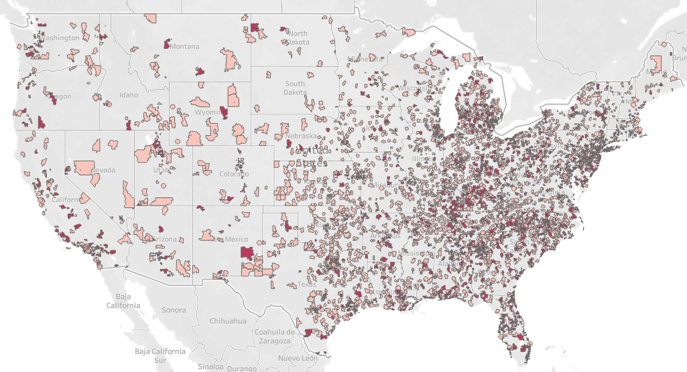
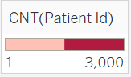
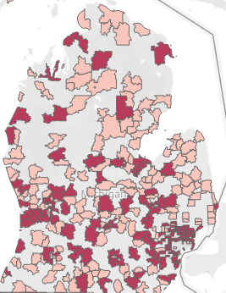
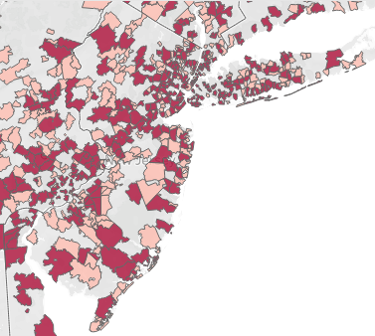
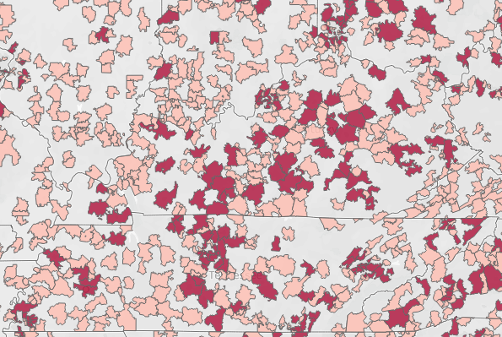
GEOGRAPHICAL REGIONS OF ‘POTENTIALS’
NNI AOM POTENTIALS
MI
NJ
KY & TN

Slide 18
AGENDA
1
PATIENT RELATIONAL DATABASE
2C
INSIGHTS AND VISUALIZATIONS – COMBINED
3
MODEL OUTPUT
4
RECOMMENDATIONS

Slide 19
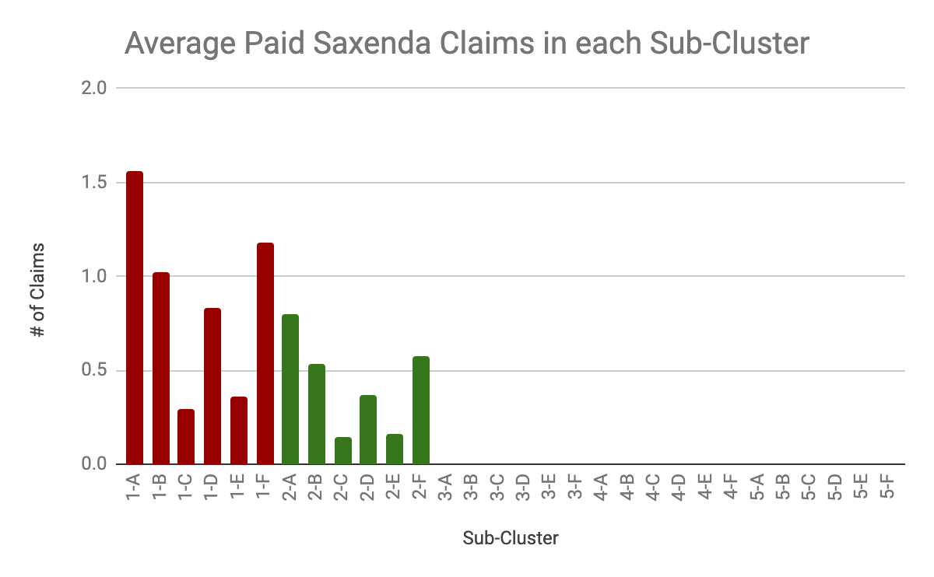
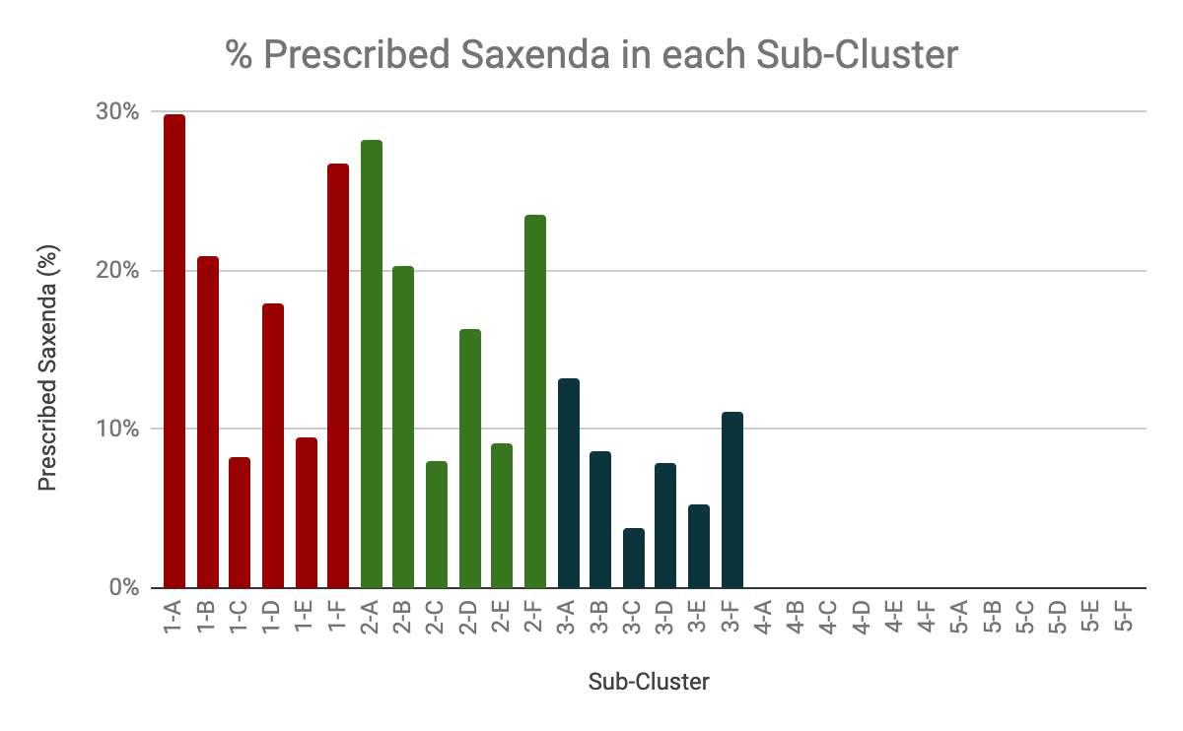
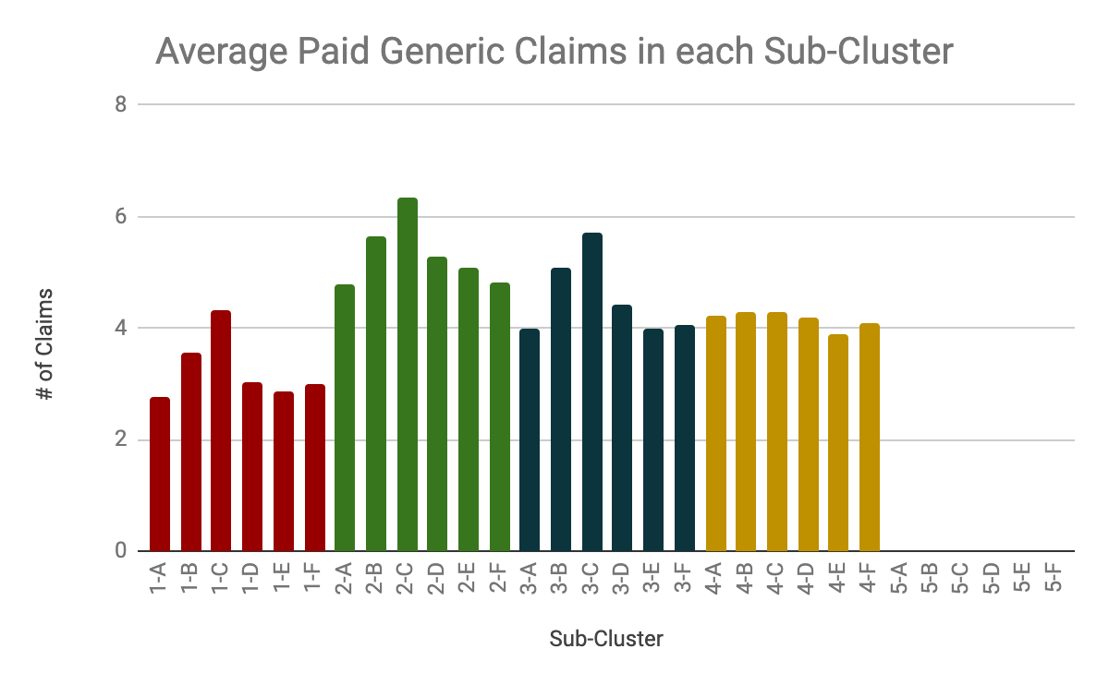
AVERAGE PAID CLAIMS AND PRESCRIPTION
Cluster 1 and 2 are Saxenda patients, Cluster 3 are rejected Saxenda patients, and Cluster 4 are Generic patients

Slide 20
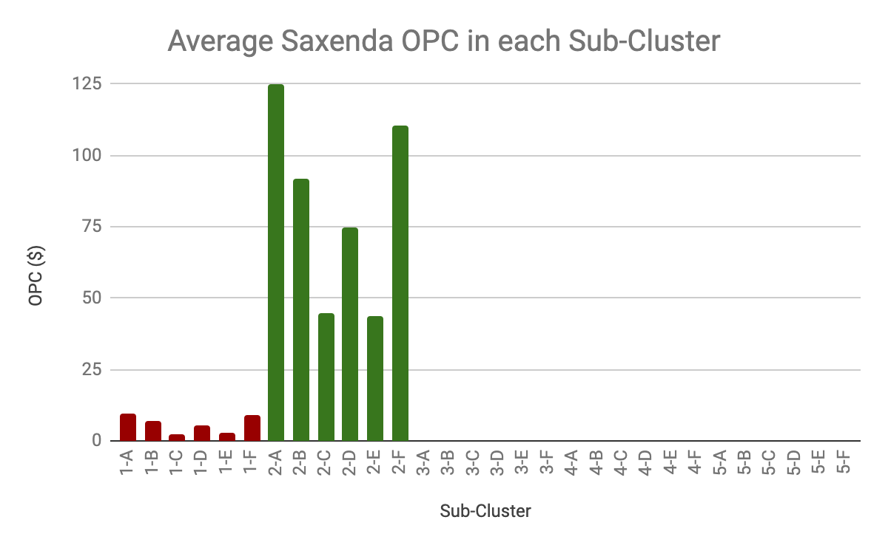
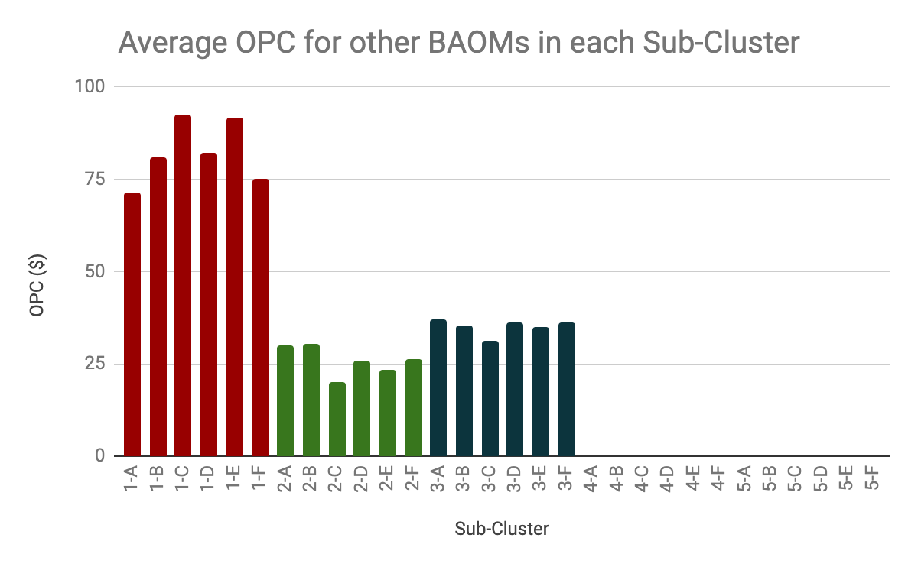
OUT OF POCKET COSTS
OPC for Groups 1 and 2 for Saxenda and Other Branded AOMs are direct opposites

Slide 21
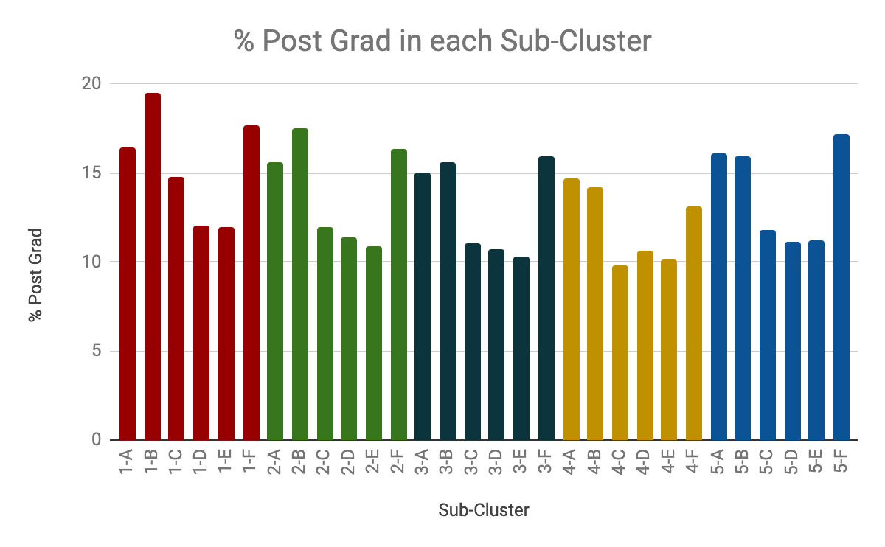
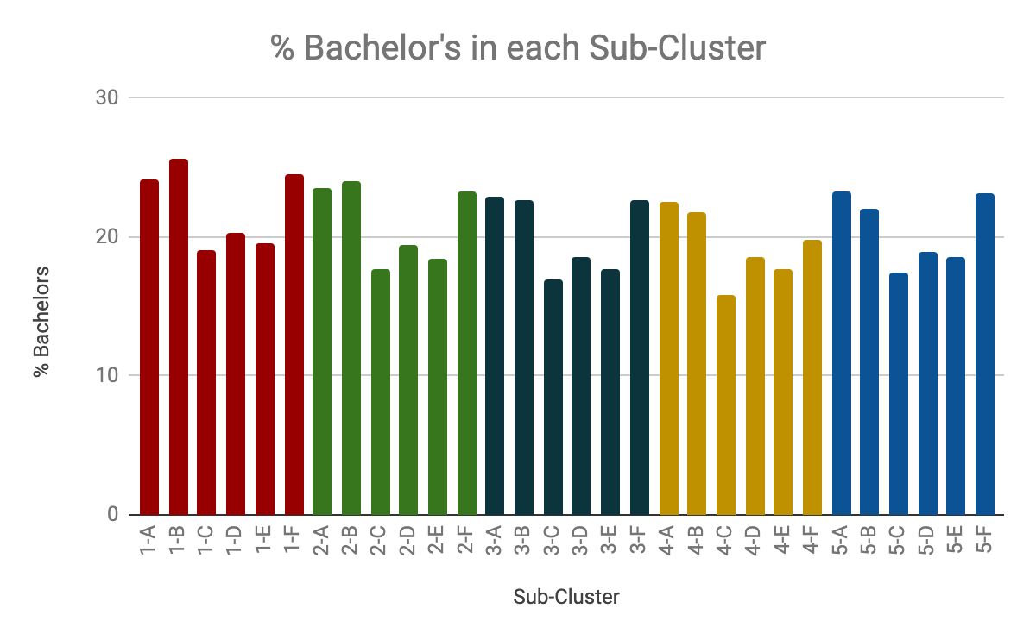
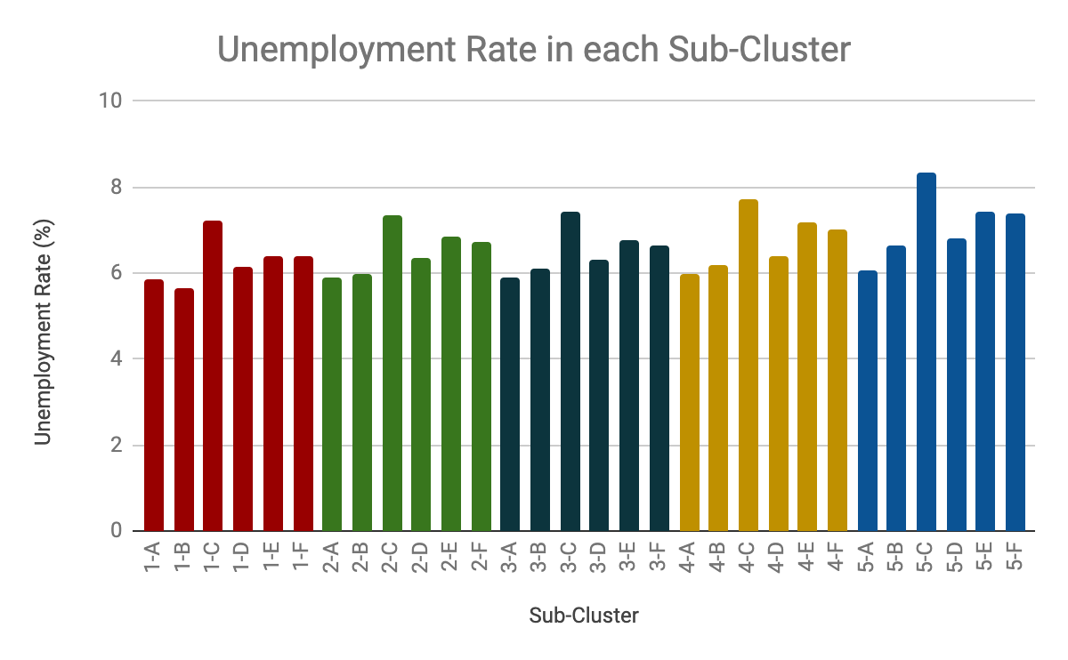
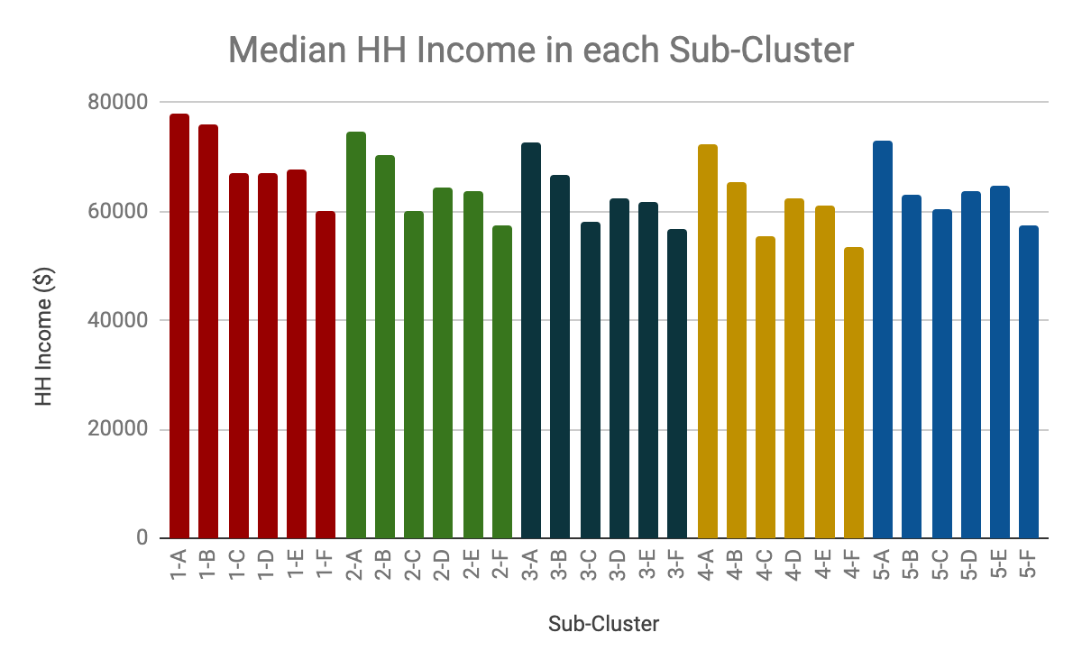
SOCIOECONOMIC DATA
Groups A and B are strong socioeconomic groups, D and F are average groups with some fluctuations, C and E are weak groups

Slide 22
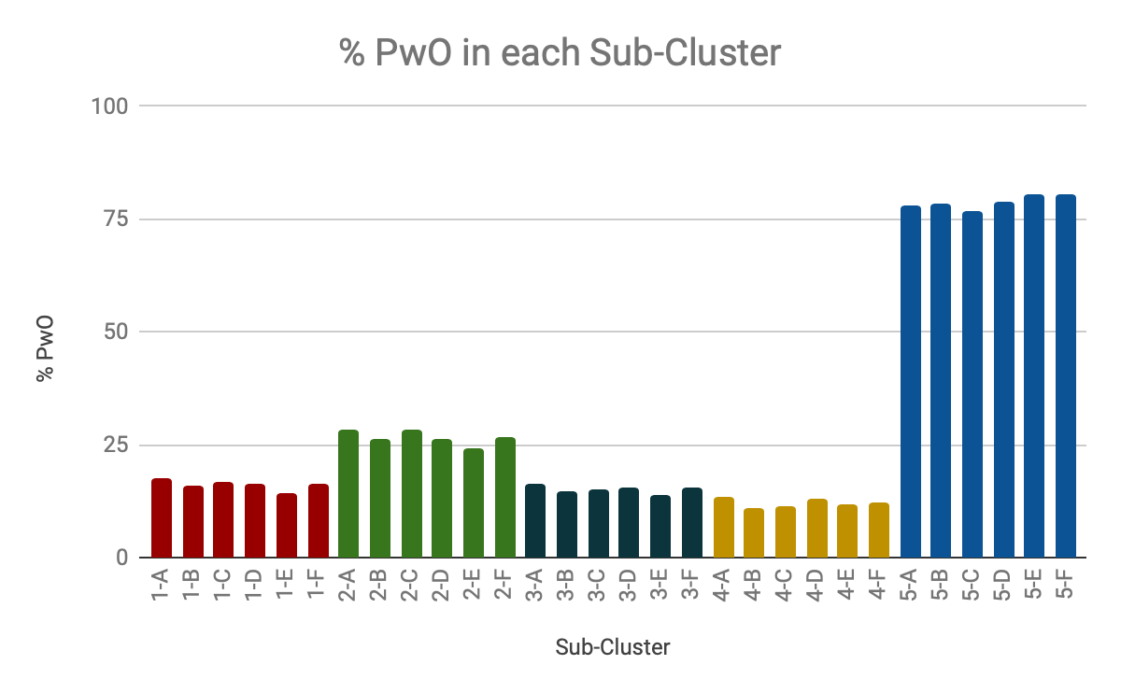
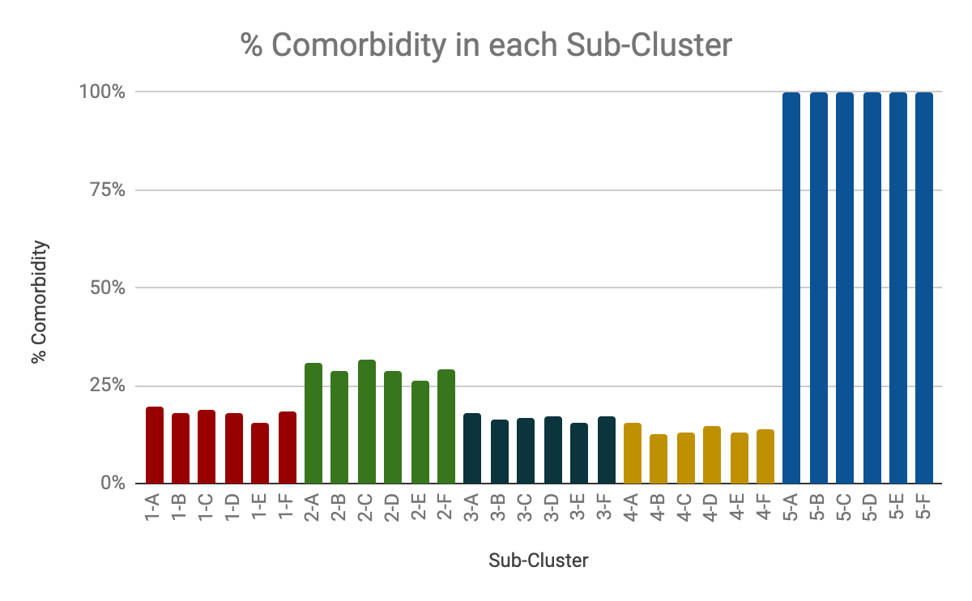
% PwO AND % COMORBIDITY
Cluster 2 has more patients with obesity and comorbidities than Clusters 1 to 4, with 5 being potential Saxenda targets

Slide 23
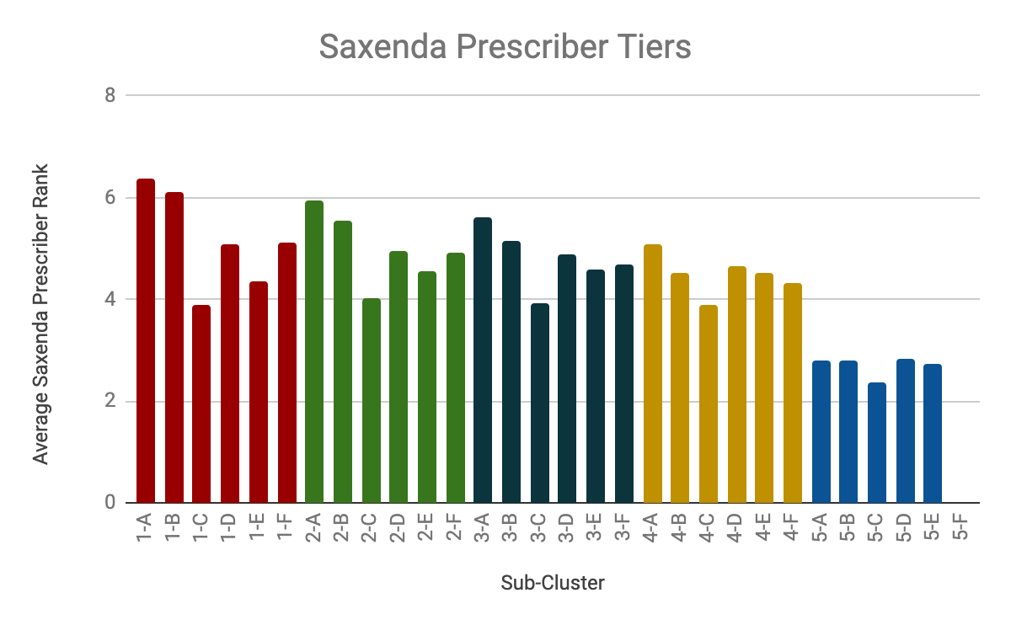
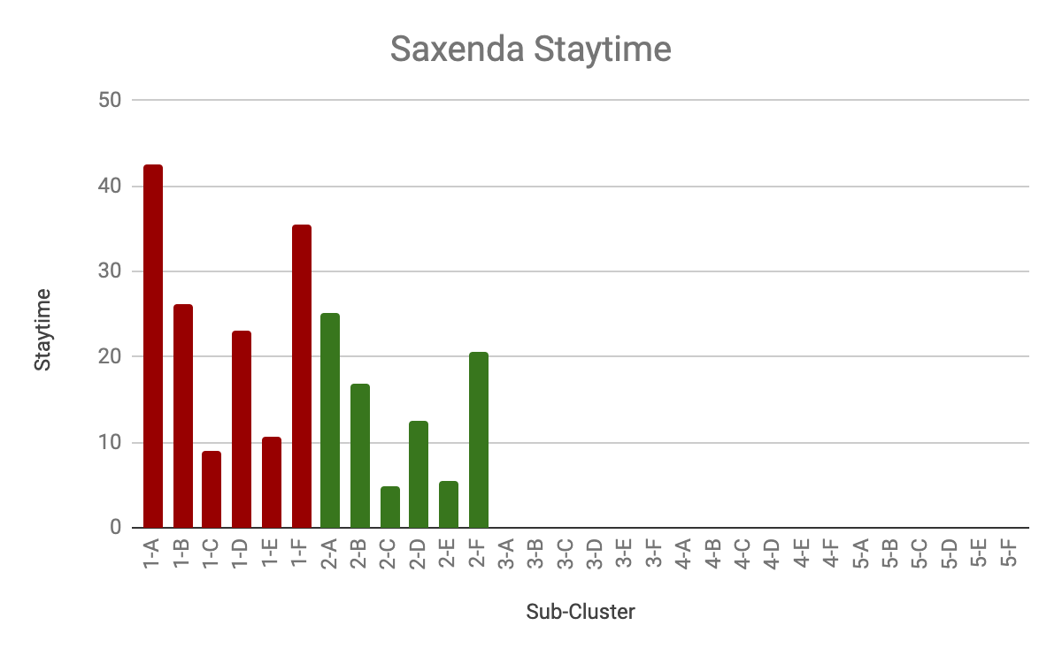
SAXENDA PRESCRIBER TIERS AND STAYTIME
Groups A, B, D and F tend to be the higher average of high-tier Saxenda prescribers and stay-time

Slide 24
AGENDA
1
PATIENT RELATIONAL DATABASE
2
INSIGHTS AND VISUALIZATIONS
3
MODEL OUTPUT
4
RECOMMENDATIONS

Slide 25

OVERALL RANKING
RANK | SUB-CLUSTER | CATEGORY
1 | 1-A | NNI AOM Enthusiasts
2 | 1-F
3 | 1-B
4 | 1-D
5 | 2-A | NNI AOM Convertibles
6 | 2-F
7 | 2-B
8 | 2-D
9 | 5-A | NNI AOM Potentials
10 | 5-D
11 | 5-B
12 | 3-A | NNI AOM Rejects
13 | 3-B
14 | 3-D
15 | 3-F
RANKS 16-30
NNI AOM Hopeless
NNI AOM Hopeless is the group of patients not worth targeting

Slide 26
MODEL INSIGHTS
ENTHUSIASTS
CONVERTIBLES
POTENTIALS
REJECTS
Recommended Targets
Highest paid Saxenda to Generic AOMs claims ratio
Highest number of High-tier Saxenda prescribers and stay-times
Strong socioeconomic status in the form of low unemployment rate, high household income, and high percentage of college graduates and post-doc
Health insurance that covers Saxenda but not other branded AOMs
Lower ratio of Saxenda to Generic AOMs claims
Second highest number of High-tier Saxenda prescribers and stay-times
Strong socioeconomic status, but prefers Generic and other branded AOMs
High out of pocket costs for Saxenda shows health insurance largely covers other branded AOMs more than Saxenda
Higher % of Patients with Obesity and Comorbidity than NNI AOM enthusiasts
Largest patient population that is untapped
Very high % of Patients with Obesity and Comorbidity
Socioeconomic status that is comparable to NNI AOM Enthusiasts group shows patients have the purchasing power to take Saxenda
Modest amounts of High-tier Saxenda prescribers show that prescribers are willing to prescribe Saxenda
Has paid claims only for Generic AOMs and Contrave
Patients are being prescribed Saxenda but all the claims are rejected
Above average socioeconomic status, slightly lower than NNI AOM Enthusiasts
Above average amounts of High-tier Saxenda prescribers
ZIPCODE – LEVEL

Slide 27
AGENDA
1
PATIENT RELATIONAL DATABASE
2
INSIGHTS AND VISUALIZATIONS
3
MODEL OUTPUT
4
RECOMMENDATIONS

Slide 28
MARKETING CAMPAIGN
2-A
ISSUE
170K patients
1) Direct competition with Contrave
Saxenda paid claims on par with Contrave paid claims, but exceed Belviq and Qsymia
2) Average OPC for Saxenda is significantly higher than generic or other branded AOMs
2-B
NNI AOM
Convertibles
36K patients
2-D
SOLUTION
204K patients
1) Marketing efforts to emphasize Saxenda’s qualities and how it differs from Contrave
2) Focus efforts on promoting health insurances that cover Saxenda to lower average OPC
2-F
15K patients

Slide 29
INVESTMENT EFFORTS
5-A
 | 5-A | 5-B | 5-D
# of patients | 4,758,646 | 1,092,234 | 7,875,741
Activated Saxenda patients | 951,793 | 218,447 | 1,575,149
Potential Revenue | $6.0 Billion | $1.4 Billion | $9.9 Billion
4.8M patients
NNI AOM
Potentials
5-B
TOTAL POTENTIAL REVENUE: $17.3 B (INCREASE FROM $5.2B)
1.1M patients
ASSUMPTIONS:
Saxenda’s lifetime value of $6,300
Stay-time of at least 6 months
Target 20% market share (Increase from current 6%)
5-D
7.9M patients

Slide 30
FUTURE PORTFOLIO: SEMA-O
Sema-O
Can be targeted to NNI AOM Convertibles:
Patients here have a lower Saxenda stay-time, suggesting that they do not like the product or may not find it effective
But patients may be willing to try a new product like Sema-O
Instead of losing these patients to competitors, these patients can be re-targeted
Can be targeted to Early Adaptors in the NNI AOM Potentials:
Patients in the Early Adaptors are willing to try something new
NNI AOM Convertibles
NNI AOM Potentials
Early Adaptors
Late Adaptors
Saxenda
Sema-O
Saxenda
Can be targeted to Late Adaptors in the NNI AOM Potentials:
Patient group who prefer traditional, reliable medication that has seen previous success

Slide 31








Salman Alahmadi
B.S. Chemical Engineering
UC Berkeley, US
Mavis Ye
B.A. Economics & Finance
Peking University, CN
Akshat Bhushan
B.S. Materials Engineering
IIT Madras, IN
Hua Yao
B.S. Civil Engineering
Tsinghua University, CN
Paula Angel
B.S. Industrial Engineering
EAFIT, CO
Jordan Tanudjaja
B.S. Chemical Engineering
Columbia University, US
Roupya Behera
B.S. Electronics & Instrumentation
CET Bhubaneshwar, IN
Shin Ler Low
B.S. Economics
University College London, UK

Slide 32
THANK YOU

Slide 33
APPENDIX

Slide 34
APPENDIX
1
PATIENT LEVEL VISUALIZATION
2
ZIP CODE LEVEL VISUALIZATION
3
MACHINE LEARNING ALGORITHM

Slide 35
PATIENT DISTRIBUTION
Cluster 5 has 19 million patients, all of them in the DX database

Slide 36
GENDER & AGE
PERCENTAGE OF MALES
AGE DURING FIRST DIAGNOSIS
Cluster 5 has the highest percentage of males and patients who are the youngest (during first diagnosis)

Slide 37
% PwO AND COMORBIDITY
% PATIENTS with OBESITY
% PATIENTS with COMORBIDITY
Cluster 5 has the most patients with obesity and comorbidities because all of its patients are in the DX database

Slide 38
STAY-TIME
Cluster 1: Highest branded AOM stay-times and lowest generic AOM stay-times
Cluster 2: Second highest branded AOM stay-times
Cluster 3: Only Contrave and generic AOM stay-times
Cluster 4: Only generic AOM stay-times
Cluster 5: No stay-times because no information on claims

Slide 39
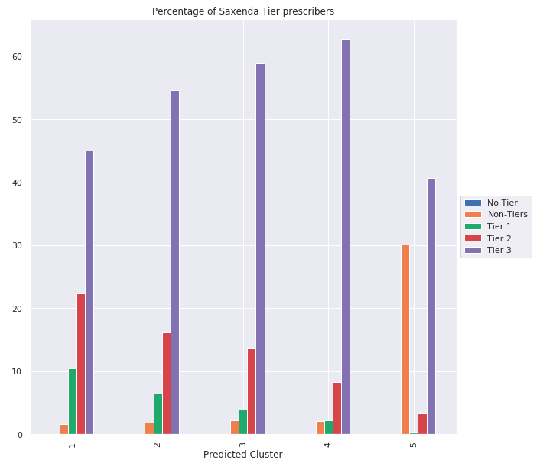
SAXENDA PRESCRIBER TIERS
Tier 3 prescribers dominate the prescribers in the LAAD database
Cluster 1:
Highest percentage of Tier 1 and Tier 2 prescribers but still lower than Tier 3
Cluster 4:
Highest percentage of Tier 3 and second lowest percentage of Tier 1 and Tier 2 prescribers
High Priority
Low Priority
Separate Group

Slide 40
EDUCATION LEVEL ACROSS CLUSTERS
Clusters 1 and 2 have the highest percentage of highly educated people and lowest percentage of lowly educated people

Slide 41
APPENDIX
1
PATIENT LEVEL VISUALIZATION
2
ZIP CODE LEVEL VISUALIZATION
3
MACHINE LEARNING ALGORITHM

Slide 42
ZIP CODE DISTRIBUTION
Group E has the largest number of ZIP codes

Slide 43
EDUCATION LEVEL ACROSS GROUPS
Groups A and B have the highest percentage of higher education (% Bachelor’s and % Post Grad)

Slide 44
UNEMPLOYMENT RATE ACROSS GROUPS
Group C has the highest unemployment rate

Slide 45
SAXENDA PRESCRIBER TIERS
Tier 3 prescribers dominate the type of prescribers across all groups
Group A has the best ratio of Tier 1 and Tier 2 Saxenda prescribers to Tier 3 prescribers
Group B has the second largest Tier 1 and Tier 2 Saxenda prescribers
Group E has the largest number of Non-Saxenda targets

Slide 46
%PwO AND COMORBIDITY
% PATIENTS with OBESITY
% PATIENTS with COMORBIDITY
Groups B and C have the largest number of patients with obesity and weight-related comorbidities

Slide 47
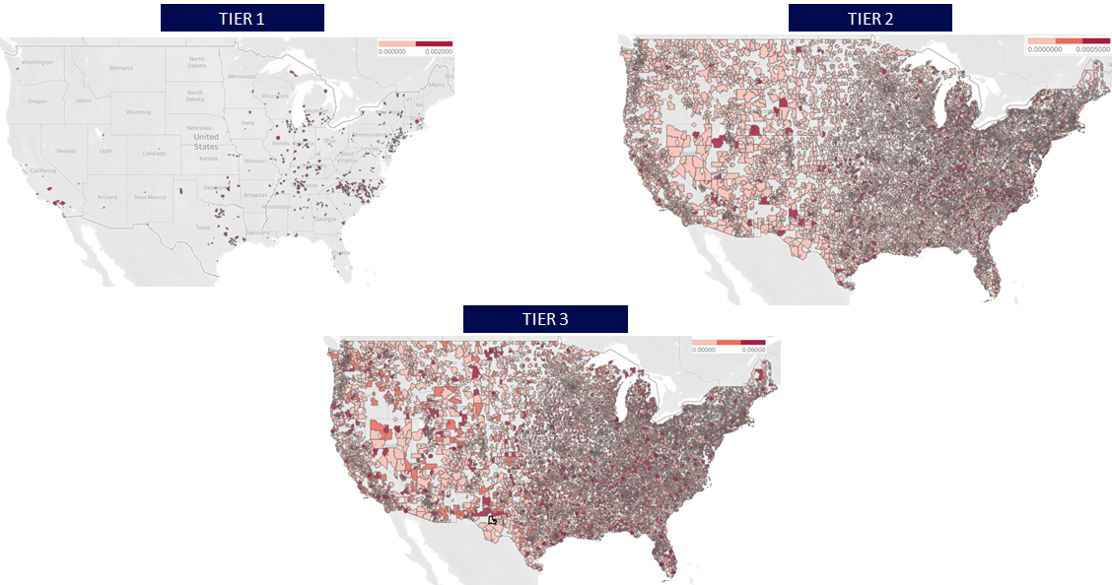
PRESCRIBER DISTRIBUTION

Slide 48
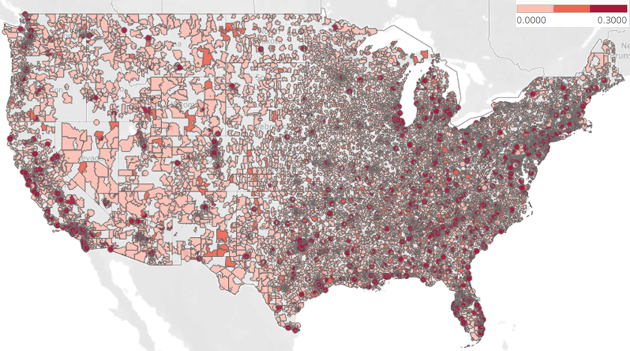
SAXENDA PLANTRAK DISTRIBUTION

Slide 49
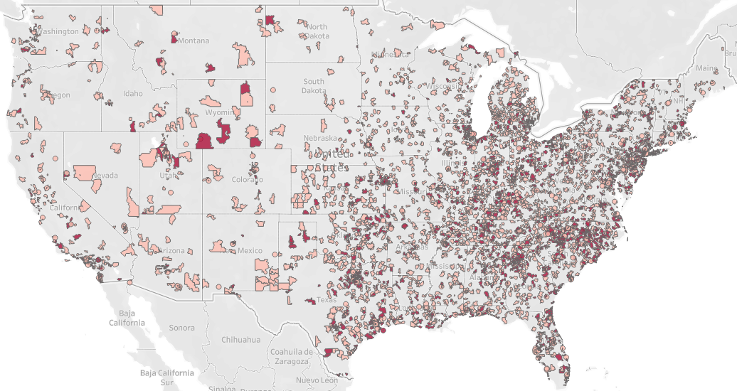
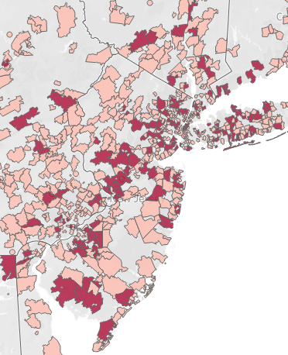
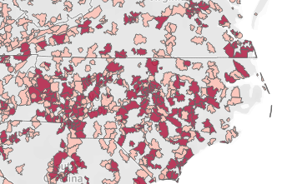
GEOGRAPHICAL REGIONS OF ‘ENTHUSIASTS'
NNI AOM ENTHUSIASTS
NY & NJ
NC

Slide 50
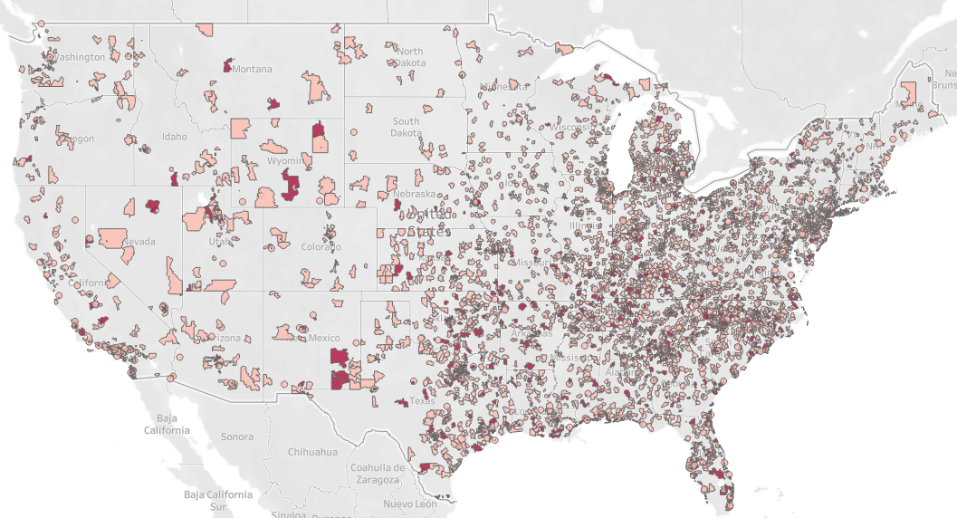
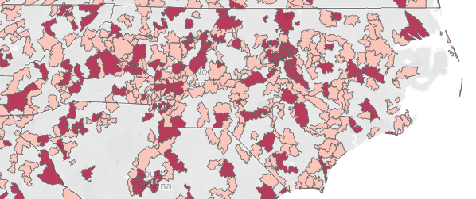
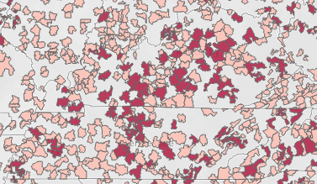
GEOGRAPHICAL REGIONS OF ‘REJECTS’
NNI AOM REJECTS
NC
KY & TN

Slide 51
APPENDIX
1
PATIENT LEVEL VISUALIZATION
2
ZIP CODE LEVEL VISUALIZATION
3
MACHINE LEARNING ALGORITHM

Slide 52
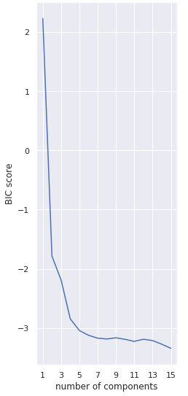
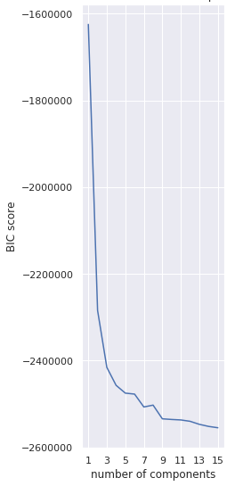
CLUSTERING AND MODEL OUTPUT
DATA PREPROCESSNG
CLUSTERING ALGORITHM
Categorical Variables
Perform label and one-hot encoding to transform categorical variables to numerical variables
Scaling and Normalization
Use Standard Scaler to transform the data to have a mean value of 0 and standard deviation of 1
Dimensionality Reduction
Use Principal Component Analysis (PCA) to reduce the dimensionality of the dataset while keeping at least 95% explained variance
Gaussian Mixture Model
A soft clustering method that measures the probability of a datapoint belonging to a specific cluster and chooses the cluster with the highest probability
Optimal Number of Clusters
Using the Bayesian Information Criteria (BIC) score, which estimates how accurate the model fits the data based on the initial number of clusters selected, we chose the number of clusters that balance error minimization without overfitting
PATIENT LEVEL CLUSTERING
ZIP CODE LEVEL CLUSTERING
ZIPCODE – LEVEL
MODEL OUTPUT
28 mil Patients
1
1-A
1-B
2
Patient Level
ZIP Code Level
5
3
4
1-C
1-D
1-E
1-F
2-A
2-B
2-C
2-D
2-E
2-F
3-A
3-B
3-C
3-D
3-E
3-F
4-A
4-B
4-C
4-D
4-E
4-F
5-A
5-B
5-C
5-D
5-E
5-F
Patient Level Clustering
Labelled 1 to 4 in the order of Saxenda prioritization, with 5 being a separate group of patients
ZIP code Level Clustering
Labelled A to E in the order of Saxenda prioritization, with F being a separate group of ZIP codes
5 DISTINCT CLUSTERS
6 DISTINCT CLUSTERS

Slide 53


GAUSSIAN MIXTURE MODEL ALGORITHM
PATIENT LEVEL CLUSTERING
The lower the BIC score, the better the fit but the optimal choice of clusters is the balance between fit and efficiency, which is determined by the elbow of the plot
ZIP CODE LEVEL CLUSTERING
5 DISTINCT CLUSTERS
6 DISTINCT CLUSTERS

